Slide 1

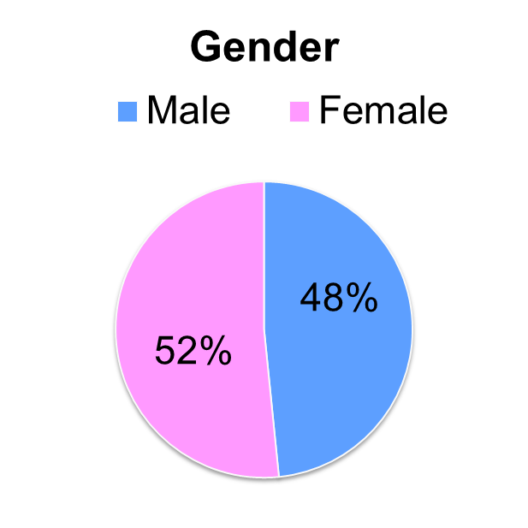
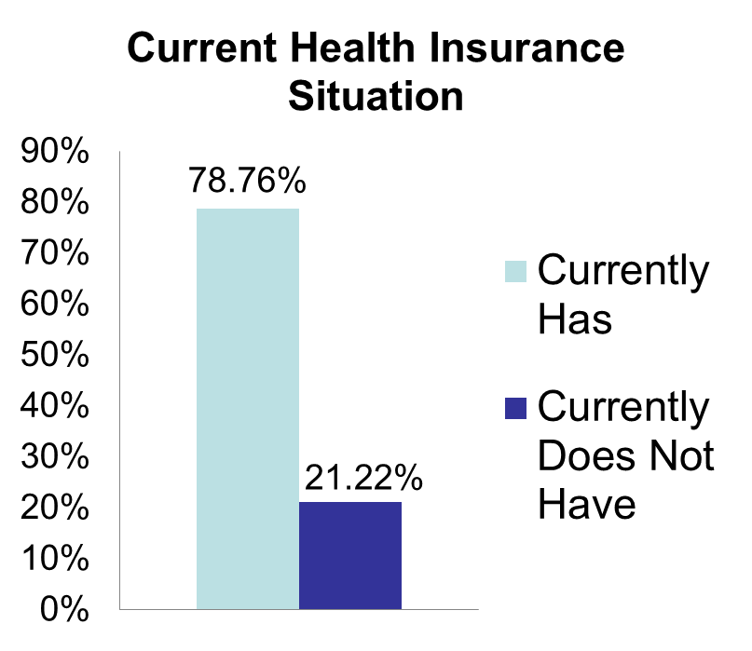
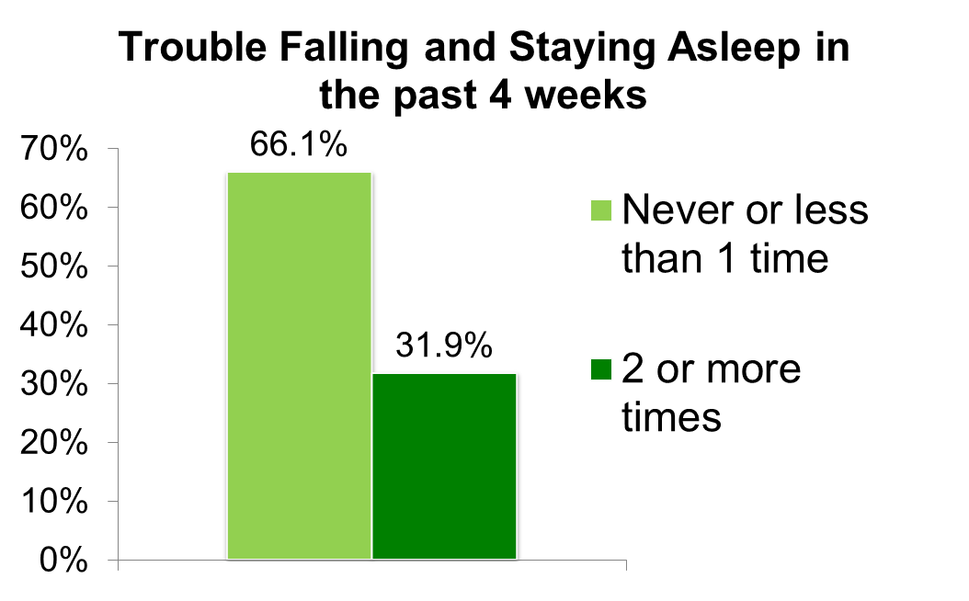
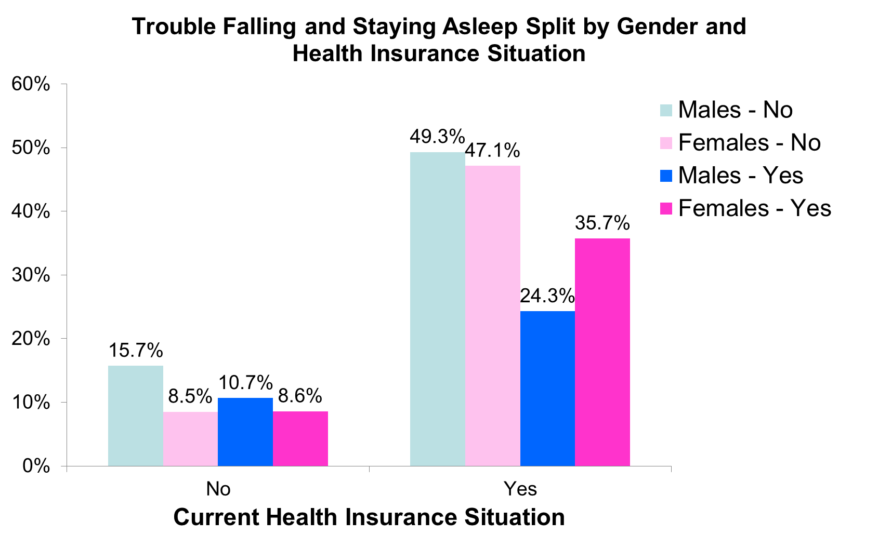
Associations between current health insurance situation and trouble sleeping
Lofink, G.
MATH615: Statistical methods for graduate research
Introduction
Distribution of Variables
Results (Cont.)
Poor sleep quality can lead to additional stress, however, there are many stressors which contribute to the disruption of adequate quality sleep which together create a cycle of further depressed sleep quality. Factors such as neighborhood, physical environment, socioeconomic status, physical activity levels, diet, alcohol consumption, and psychological factors including loneliness, anxiety, fear, depression, and uncertainty of one’s future have all been shown to affect the quality of sleep. A review of the literature shows there are conflicting views as to which influences which, sleep changing perceived stress or stress altering sleep patterns. The research project will examine the relationship between a person’s current health insurance status and its effect sleep quality while taking into consideration mental health.
There is a complex relationship between sleep and mental health. Circadian rhythms and sleep patterns are significantly affected by chronic and acute stress (Ahrberg et al 2012 and Marco et al 2011). While poor sleep quality can lead to additional stress, many stressors contribute to disruption of adequate quality sleep creating a cycle of poor health and further depressed sleep quality. Psychological factors most often associated with trouble sleeping including loneliness, anxiety, fear, depression, and uncertainty of one’s physical and financial future (Kurina et al 2011, Marco et al 2011, Hale et all 2012, Ahrberg et all 2012). Previous research has conflicting views on which influences which, sleep changing perceived stress or stress altering sleep patterns.
While adults with lower socioeconomic status are more likely to struggle affording health care and may forgo health insurance, a link between lack of affordable care or lack of health insurance to significant psychological stress has not been clearly established. It remains unclear if there is one factor or a collection of similar factors that are more influential to sleep disturbances. Furthermore, the degree to which health care and health insurance access significantly contribute to stress and stress related psychological symptoms and in turn the effect on quality of sleep remains unanswered.
The aim of this analysis was to examine the association between an individual’s current health insurance situation and how often they have trouble falling or staying asleep over a four week period. Further exploration investigated if the association differed with gender or mental health factors.
 | Mean | Median | St. Deviation | Range
CESD Depression Scale | 2.61 | 2.0 | 2.6 | [0,15]
Cohen Perceived Stress Scale | 4.81 | 5.0 | 2.9 | [0,16]
Anxious Scale | 12.3 | 12.0 | 2.1 | [4,20]
When entered individually and collectively into the model each confounding variable significantly improved fit and strength of significance. The original X²=11.822 p=0.001 and after adding the other variables X²=512.691 p<0.001. Furthermore, the beta and odds ratio of mental health alone was not significant (p=0.425).
Changes in Associations between Trouble Sleeping and Health Insurance depending on Mental Health Factor
 | OR | 95%CI
Currently Has Health Insurance YN(1) | 1.06 | (0.92 - 1.20)
CESD Depression Scale | 1.17** | (1.13 - 1.20)
Cohen Perceived Stress Scale | 1.07** | (1.04 - 1.09)
Anxious Scale | 1.10** | (1.07 - 1.12)
Binary Logistic Regression *p<.01 **p<.001
Methods
Individuals without health insurance have a non-significant 1.06 great odds of having trouble falling and staying asleep than those who do have health insurance (p=.425).
When considering depression, perceived stress, and anxiety, they each have significant increased odds of an individual having trouble sleeping (1.07, 1.17, and 1.10 increased odds respectively; p<0.001) .
Participant response data is drawn from the AddHealth Wave IV cohort. This analysis includes 4,993 adult men and women ages of 25-34 who were interviewed between 2008-2009.
All variables of interest were explored numerically and visually using descriptive tables, bar charts and histograms. After exploration and visualization the CESD Depression scale was log transformed. All other scales were relatively normal in distribution.
Bivariate associations were examined using bar charts, box plots, chi-squared, t-tests, and one-way ANOVA.
Research questions were analyzed using chi-squared, logistic regression, and further explored after splitting the data based on gender.
Gender was tested and determined to not be a moderator.
Depression, perceived stress, and anxiety were tested determined to be confounders.
Conclusions
Previous studies reported stronger positive associations between negative mental health markers - such as depression, stress, and anxiety - and sleep disturbances. The hypothesis that health insurance significantly increases the chances of having trouble sleeping was not supported by this analysis; while the mental health factors did play a role in sleep quality outcomes. In the studies analyzing sleep quality and mental health, health insurance was not taken into account therefore it is not possible to say is these results are typical.
This investigation of interactions between variables did not look at the possible effects of one’s health insurance situation and the mental health factors or depression, stress, or anxiety. Further research should be done to assess how a person’s health insurance situation may be affecting mental health and if in turn those effects contribute to how often a person has trouble falling and staying asleep.
Variables of Interest
Results
Health Insurance Situation |  | Trouble Falling and Staying Asleep
Recorded from a multilevel categorical variable to a binary variable (has health insurance yes/no) |  | Recorded into one scale variable and a binary variable (trouble sleeping yes/no)
Comparing health insurance situation and trouble sleeping, there is a weak significant relationship (X²=11.92, df=1, p=0.001). The odds of a person without health insurance having trouble sleeping is 1.271 times higher than for a person with health insurance (95% CI 1.109-1.456).
Associations between Trouble Sleeping and Health Insurance Situation
n=5022 | OR | 95% CI
Health Insurance (No/Yes) | 1.271 | [1.1,1.5]
Trouble Sleeping = Yes | 1.150 | [1.1,1.2]
Trouble Sleeping = No | .905 | [.9,1.0]
Depression Scale |  | Perception of Stress |  | Anxious Scale
A score based on how often a person experiences depression symptoms |  | A score based on how often a person experiences stress symptoms |  | A score based on how often a person experiences anxiety symptoms
References
Ahrberg, K., Dresler, M., Niedermaier, S., Steiger, A., Genzel, L. (2012). The interaction between sleep quality and academic performance. J. of Psychiatric Research, 46, 1618-1622. http://dx.doi.org/10.1016/j.jpsychires.2012.09.008
Hale, L., Hill, T. D., Friedman, E., Nieto, F. J., Galvoa, L. W., Engelman, C. D., Malecki, K. M.C., Peppard, P. E. (2012). Perceived neighborhood quality, sleep quality, and health status: evidence from the Survey of the Health of Wisconsin. Social Science and Medicine, 79 (2013), 16-22. http://dx.doi.org/10.1016/j.socscimed.2012.07.021
Kurina, L. M., Knutson, K. L., Hawkley, L. C., Cacioppo, J. T., Lauderdale, D. S., & Ober, C. (2011). Loneliness is associated with sleep fragmentation in a communal society. Sleep, 34 (11), 1519-1526. http://dx.doi.org/10.5665/sleep.1390
Marco, C. A., Wolfson, A. R., Sparling, M., & Azuaje, A. (2011). Family socioeconomic status and sleep patterns of young adolescents. Behavioral Sleep Medicine, 10, 70-80. DOI: 10.1080/15402002.2012.636298
Research Questions
Is lack of health insurance associated with difficulty falling and staying asleep?
Is the relationship between health insurance and difficulty falling and staying asleep significantly influenced by negative mental health markers (depression, anxiety, stress)?
Does the relationship between health insurance and trouble falling and staying asleep differ between genders?
The association between trouble falling and staying asleep and health insurance remained significant at p=.001 after testing gender as a moderator.
Contact Information: gbarton1@csuchico.edu

